Slide 1
ONLINE RESTAURANT SYSTEM (Ordering and Delivery)

Slide 2
FEASIBILITY STUDY :
Technical feasibility
Economic feasibility
Organizational feasibility

Slide 3
:Technical feasibility
Familiarity with technology:
Our team has good experiences and sufficient knowledge to deal with technology and desktop application, and if they do not have sufficient experience in desktop application, we will give them sufficient training and courses on how to deal with desktop application.
compatibility:
The system integrate with servers (computers) and desktop application and GPS device and food inside the restaurant and the operations of delivering food to homes and reserving food or a table inside the restaurant.
Project Size :
Medium project not have more risk (because it is easy to use because of the instructions on how to use it correctly and because it saves time and effort).
Familiarity with Application:
We should have aware of working process of communication with restaurant management system.

Slide 4
Economical feasibility
Total | Year 3 | Year 2 | Year 1 | Year 0
11200 | 6000 | 2200 | 3000 |  | Total Benefits
8500 | 3500 | 1800 | 1120 | 2080 | Total costs
2700 | 2500 | 400 | 1880 | [2080] | Net Benefits
 | 2700 | 200 | [200] | [2080] | Cumulative Net Cash Flow

Slide 5
B.E.P=YEARS NAGATIVE +(YEAR NET CASH – YEAR COMM)/YEAR COMM B.E.P=1+(400-200)/400=1.5 ROI=(TOTAL BENEFIT-TOTAL COST )/TOTAL COST ROI=(11200-8500)/8500 =31%

Slide 6
From my point of view , the direction of organizational process, this project has low risk. The objective of the system, which is to increase income, easily dealing with the restaurant by online, facilitate payment methods (credit or cash).
Organizational feasibility:

Slide 7
Level 0 (logical)

Slide 8
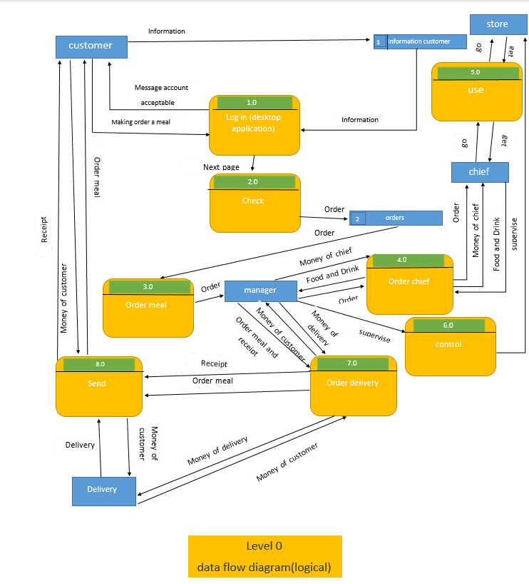

Slide 9
Level 0 (physical)

Slide 10
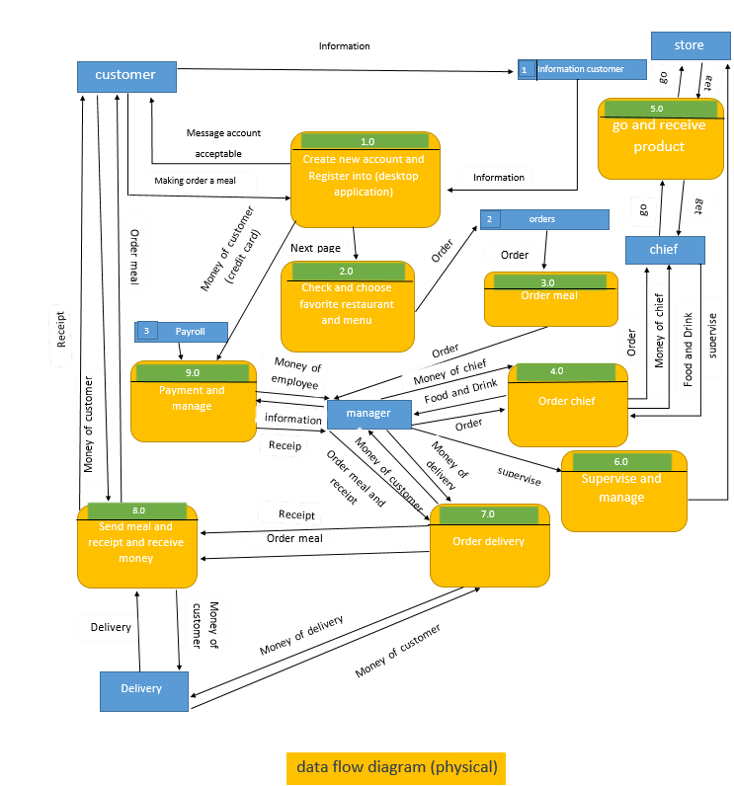

Slide 11
Context level

Slide 12
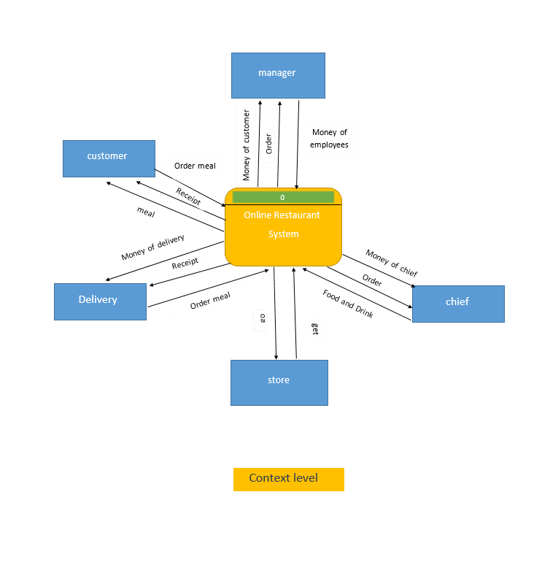

Slide 13
Level 1

Slide 14
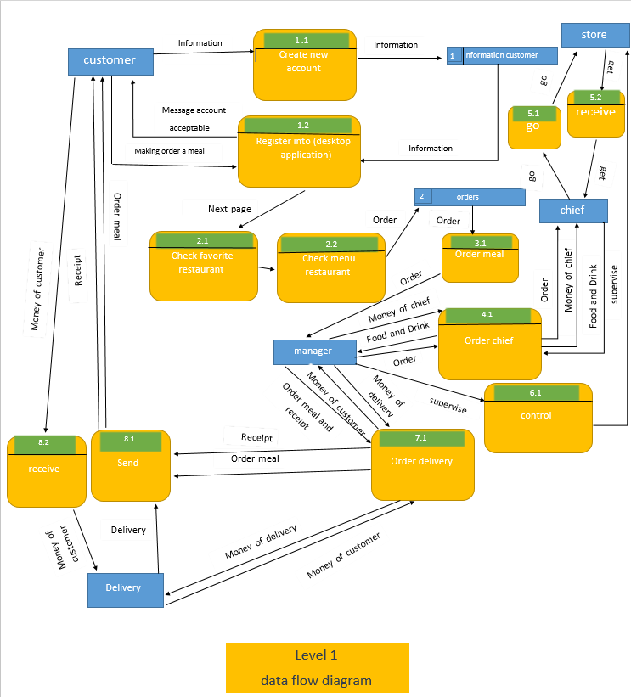

Slide 15
ERD Diagram

Slide 16
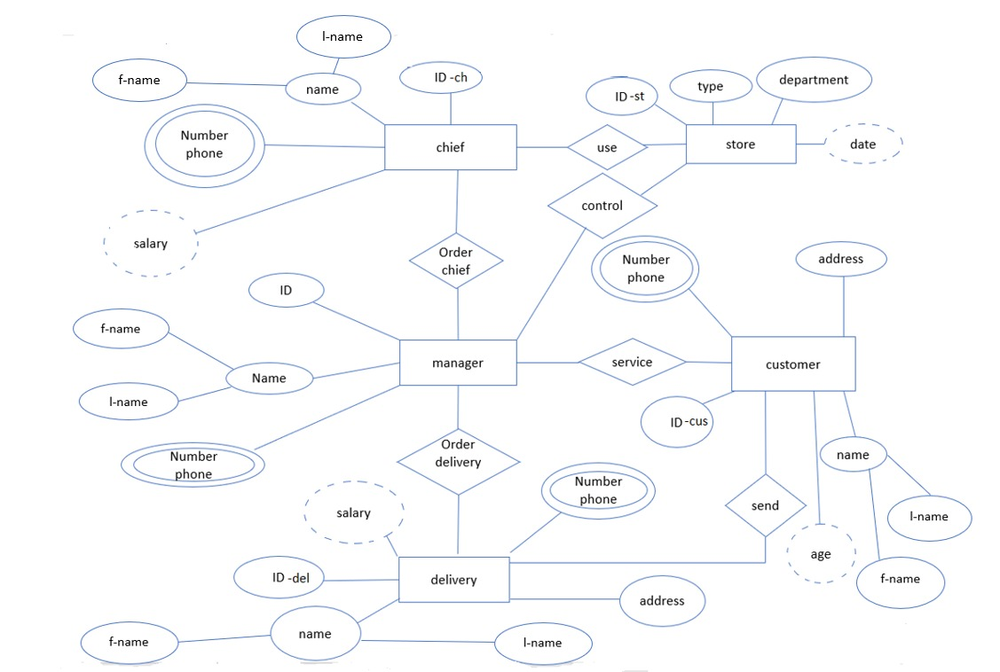
N
1
N
N
1
1
1
N
1
N
N
N

Slide 17
schema

Slide 18
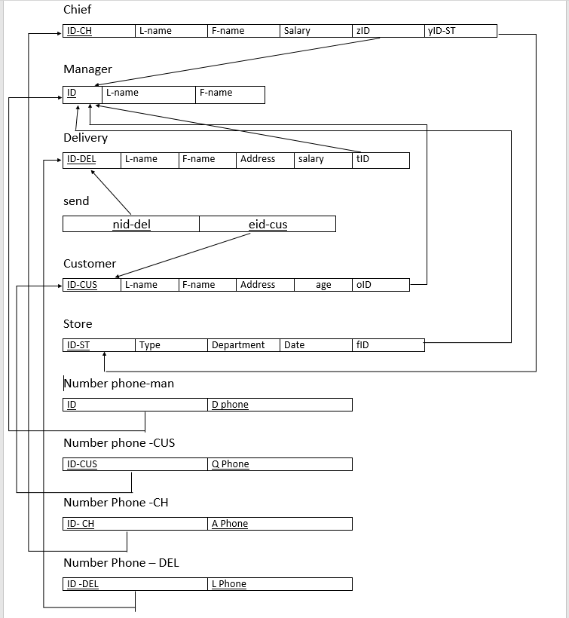

Slide 19
Data dictionary

Slide 20
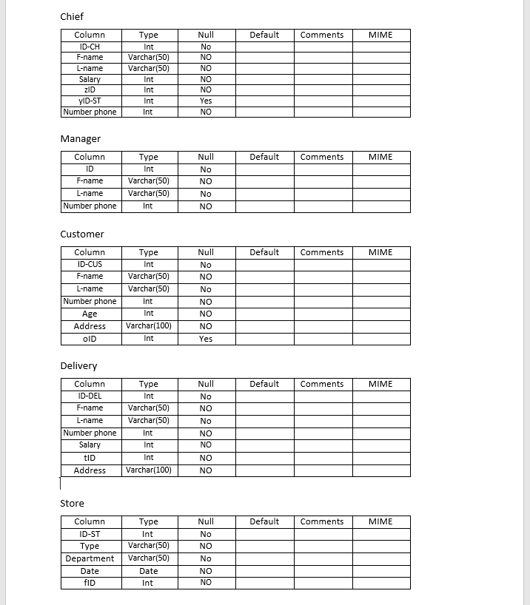

Slide 21
Use case Diagram

Slide 22
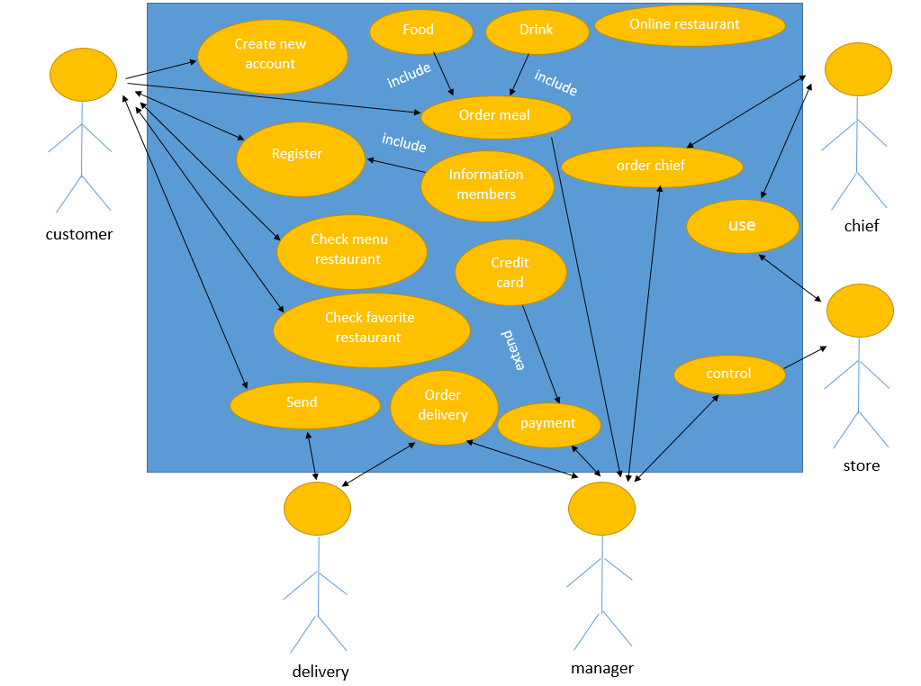

Slide 23
Use case scenario

Slide 24
Use case :1 use case name: create account actors: owner, customer priority: high TYPE: external. Trigger : user selects the “crate account user" link. Description: the create account use case allow owner and customer to create their accounts and become a registered member. Preconditions: none Normal course: 1.The customer enter the full name, new email address and new password. 2.The manager enter the full name, new email address, new password and name of the restaurant and address of the restaurant. 3.The system will ask them to choose strong password. 4.The system will ask to reenter into the confirm password. 5.The account will be created after click on sign up button.

Slide 25
Alternative courses: 1-invalid entry of information: -the system will show the message to reenter the valid data. 2-weak password: -the system will show the message to enter strong password. 3-password not match is at least 8 words: -the system will show the message to reenter the password . Post conditions: 1.The manager and customer are now member. 2.The system display all features to which customer and manager are associated with as defined in their account.

Slide 26
Use case :2 use case name: register actors: owner , customer priority: high type: external. Trigger : user selects the “loge in" link. Description: this use case allow customer (members)to loge in system for choose favorite restaurant and meal and owner (members)to loge in system for see number of viewers , participants , fans and evaluation of the restaurant. Preconditions: customers and owner should be from members(create new account). Normal course: 1.The customer and your email address and your password and name of the restaurant which you want it. 2.The owner enter your email address, your password and your name of the restaurant.

Slide 27
Alternative courses: 1- customers and managers should not be members. 2-customer and manager enter a wrong password or email. Post conditions: 1.The manager and customer are registering into system(online restaurant).

Slide 28
Use case :3 use case name: check favorite restaurant actors: customer priority: high type: external. Description: this use case allow customer to click button search and choose for their favorite restaurants . Trigger : searching for favorite restaurant and selecting favorite restaurant. Preconditions: 1.The customer should be registered. Normal course: 1.Search bar appear on homepage. 2.The customer enter the restaurant name and address. 3.Search next bar appear on homepage. 4.The customer enter the restaurant address. 5.Now customer click on the search button. 6.The system displays the available restaurant in that area or the restaurant the customer looking for.

Slide 29
Alternative courses:
No restaurant available:
The system display the message sorry no restaurant available in that area. Post conditions: 1.The system display the restaurant that customer searched.
2.The system does not display the nearby restaurant incase searched restaurant not available.
3.The system display the nearby restaurant incase searched restaurant is available.

Slide 30
Use case :4 use case name: check menu actors: customer priority: high type: external. Trigger : this use case allow customer to click button check the menu of restaurant. Description: searching for menu and selecting meal. Preconditions: 1.The customer should be registered. 2.The customer should search for restaurant. Normal course: 1.The customer search for restaurant. 2.The system displays the restaurant section. 3. next part on homepage. 3.The check menu button appear in next page. 4.The customer choose meal and size it and price it from menu.

Slide 31
Alternative courses:
No meal available
2.The system display the message sorry no meal in that menu. Post conditions: 1.The system display meal that customer searched.
2.The system does not display meal incase searched meal not available in menu.
3.The system display meal incase searched meal is available in menu.

Slide 32
Use case: 5
Use case name: order meal
Priority: high
Actor: customer ,manger
Description:
A process in which the customer make order meal after select meal.
Trigger:
The customer make order meal
Type: external.
Pre-condition:
Customer should be register.
choose meal.
Normal case:
the customer will select meal that he wants it.
The customer will select by accept button(make order meal).

Slide 33
Post condition:
1- the order meal will send to restaurant.
2-the manager and the chef will receive order meal from customer.
Alternative course:
1-the order meal will not send to restaurant because weak or cut internet.
2-the manager will receive order meal from customer because weak or cut internet..

Slide 34
Use case: 6
Use case name: order chief
Priority: high
Actor: chief , manager
Description:
A process in which the chief take order from manager and chief send food and drink to manager and chief receive money from manager.
Trigger:
the chief take order from manager and he send food and drink to manager and he receive money from manager.
Type: external.
Pre-condition:
Order meal should be available.
Normal case:
1.Chief will take order from manager.
2.Chief will cook food.
3.Chef will give food and drink to manager. 4. chief receive money from manager.

Slide 35
Post condition:
1- the food was ready by chief.
2-the manager takes it from the chief to prepare it for delivery , to sent to customer.
Alternative course:
The chef is not finished cooking and he is too late.
Order meal is not available(exist).

Slide 36
Use case :7 use case name: delivery order. actors: delivery and manager priority: high
Type: external.
Trigger : the chief take meal from manager and he send money customers to manager and he receive money from manager. Description A process in which the delivery take meal from manager and delivery send money customers to manager and he receive money from manager.
Preconditions: 1.The chef should be finish cooking food normal course: 1.The manager prepare food and drink when chef finishes cooking food.
2.Delivery confirm from food and drink when chef finish cooking food.

Slide 37
Alternative courses:
1.The chef does not finish cooking food. Post conditions:
1.The meal will be send to customer incase food and drink confirmed and prepared by delivery and manager .
2. The meal will not be send to customer incase food and drink did not confirm and prepare by delivery and manager .

Slide 38
Use case: 8
Use case name: payment.
Priority: high
Actor: customer
Description:
A process in which the customer choose how to pay for restaurant.
Trigger:
Pay to restaurant.
Type: external.
Pre-condition:
If payment is cash ,customer will pays after he will take meal.
If payment is credit card ,customer will pays before he will make order.
Normal case:
Customer will determine how he will pay for restaurant.
If customer will pay cash ,he will pays it to delivery.
If customer will pay credit card ,he will write credit card number on system.

Slide 39
Post condition:
-If customer payed cash , delivery will get it.
-If customer will pay credit card , system will send massage with confirmation payment.
Alternative course:
Customer does not have the money in cash :-
-pay money by credit card.
2-if the visa is empty:-
-Pay money by telecommunications waiter or manager.

Slide 40
Use case: 9
Use case name: send.
Priority: high
Actor: delivery
Description:
A process in which the delivery delivers order into customer.
Trigger:
Deliver order into customer.
Type: external.
Pre-condition:
Preparing food and drink (meal) should be finish.
Normal case:
Deliver will take order.
Delivery will confirm order.
Delivery will deliver order into customer.

Slide 41
Post condition:
Customer will receive order from delivery and give he baksheesh .
alternative course:
Customer receives order is wrong.
Delivery is very late about the delivery of order.

Slide 42
Question form

Slide 43
1- How satisfied are you overall with the food and service in our restaurant? 2-Do you have any suggestions or criticisms to improve our services or the quality of our food? 3- Will you visit our restaurant again to order food? 4- Do you recommend our restaurant to your friends? 5- Are the restaurant opening hours appropriate? 6- Would you like to know our discounts or special offers? 7- How healthy and fresh did you find your food? 8- Did you like our menu? 9- Was the food delivered to you on time? 10- What do you think of food packaging and serving utensils? 11-What do you think should be added to the menu in our restaurant? 12-How do you usually choose your restaurant?

Slide 44
Interview question

Slide 45
1-Why do you enjoy working in the restaurant industry? 2-What do you think are the most important skills for this restaurant role? 3-What does excellent customer service mean to you? 4-How do you handle conflicts with coworkers? 5-Describe a time you managed an impatient customer in a restaurant. 6-How do you handle your mistakes when working in a restaurant? 7-What would you do if a customer ordered a dish that wasn’t on the menu? 8-What’s your greatest strength as a restaurant worker? 9-What hours are you available to work? 10-Have you dined at this restaurant before? What makes our restaurant unique?

Slide 46
Thank you

